Slide 1
PROJECT TITLE-HOSPITAL FINDER
PIP104 PROFESSIONAL PRACTICE-II
VIVA-VOCE
Batch Number: 30
Roll Number 20201CSD0158 20201CSD0161 20201CSD0196 20201CSD0204 | Student Name : Rahul A Satish Babu G Nitish K Manoj kumar S
Under the Supervision of,
Mr. Shobhit Tembhre
School of Computer Science Engineering
Presidency University

Slide 2
Introduction
In the contemporary era of digitization and increased reliance on technology, the healthcare sector is undergoing a transformative shift towards providing more accessible and efficient services.
One significant aspect of healthcare accessibility is the ability for individuals to promptly locate and access nearby medical facilities.
Access to timely and quality healthcare is paramount for overall well-being, especially in emergency situations or when individuals are in need of specific medical services.

Slide 3
Literature Review
The Evolving Landscape of Healthcare Accessibility:
In a seminal work by Beratarrechea et al. (2013), the authors emphasize the critical importance of accessible healthcare in improving health outcomes.
They argue that spatial accessibility is a key determinant of healthcare utilization, and technology-driven solutions, such as Hospital Finder applications, have the potential to bridge geographical gaps between individuals and medical facilities.
Geospatial Technologies in Healthcare Navigation:
Geospatial technologies have been integral to the development of Hospital Finder applications. Li et al. (2018) highlight the significance of Geographic Information Systems (GIS) in enhancing healthcare navigation.

Slide 4
Literature Review
Frost & Sullivan [9] (2017) - prevent medical accidents in advance by using an integrated solution based on information and communication.
Karen Taylor [10] (2017) - improving treatment procedures for existing patients and introducing new functions.
European Union Agency for Network and Information Security [11] (2016) - A hospital that improves the patient treatment process based on IoT.
Korea Embedded Software and System Industry Association [12] (2018)
Seoul Asan Hospital Innovation Design Center [2] (2020) - A next-generation hospital that exceeds the limits of existing hospitals in terms of quality of care.
Ministry of Health and Welfare [13] (2020) - provides medical services by applying ICT such as 5G and IoT to improve medical services such as enhancing patient safety.

Slide 5
Research Gaps Identified
Identifying research gaps in healthcare management system app development using Java
may involve several considerations.
Interoperability and Integration : Explore ways to enhance interoperability with other
healthcare systems and integrate seamlessly with diverse data sources.
Security and Privacy : Investigate methods to strengthen security measures and ensure
robust privacy protection, considering the sensitive nature of healthcare data.
Usability and User Experience : Evaluate and improve the user interface and overall user
experience to optimize the application for healthcare professionals and patients.
Scalability and Performance : Research scalable architectures and methods to improve the
app's performance, especially as data volumes and user numbers increase.

Slide 6
Proposed Methodology
Instead of making the patients shift from hospital to hospital for required service.
There are two types of applications involved in this project.
The administrator of the application adds all the details of cities, areas, hospitals, diseases, symptoms, department and
The users or patients can get registered with the application to avail all the service.
The users can view the hospitals and services provided, and also perform search based on city, hospitals and department names.
The proposed application is a very diverse application which can easily be accessed by the registered members of the application.

Slide 7
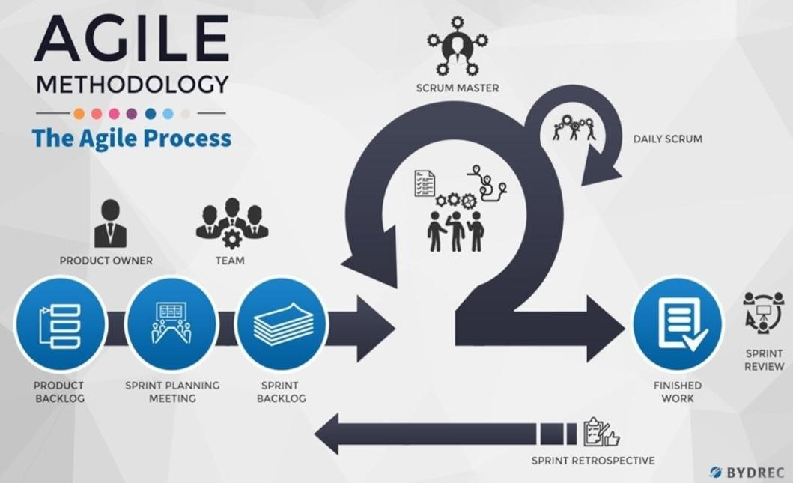
Proposed Methodology
Agile is an iterative and incremental approach to software development that emphasizes flexibility, collaboration, and customer satisfaction.
It's particularly well-suited for projects where requirements are expected to change or evolve over time.
The Agile methodology is based on the principles outlined in the Agile Manifesto and is often implemented using various frameworks such as Scrum or Kanban.

Slide 8
Objectives
The primary objectives of this research are:
1. To design and develop a user-centric mobile application, Hospital Finder, that utilizes geospatial technologies to provide real-time information on nearby healthcare facilities.
2. To create a comprehensive and up-to-date database of hospitals, clinics, and healthcare providers, including information on specialties, services offered, and user reviews.
3. To implement advanced search and filter functionalities, enabling users to tailor their searches based on specific medical requirements and preferences.
4. To integrate features such as real-time availability updates, emergency services locators, and appointment scheduling to enhance the overall healthcare-seeking experience.
5. To evaluate the impact of the Hospital Finder app on healthcare accessibility, user satisfaction, and the efficiency of healthcare service utilization.
By addressing these objectives, this research aims to contribute valuable insights into the development, functionality, and impact of mobile applications in improving healthcare accessibility.

Slide 9
System Design & Implementation
The purpose of the design phase is to plan a solution of the problem specified by the
requirements document. This phase is the first step in moving from the problem domain to
the solution domain.
- How to satisfy the needs. The design of a system is perhaps the most critical factor affecting
the quality of the software; it has a major impact on the later phases particularly testing .
ARCHITECTURAL DESIGN
Architecture focuses on looking at a system as a combination of many different components,
and how they interact with each other to produce the desired result.
Identifying components or subsystems and how they connect.
As a developer, the Java framework and Android Studio present many choices for choosing
the right architecture, from placing the data access code directly in the UI through datasets
and data source controls, to creating a data access layer that talks to the database, all the way.

Slide 10
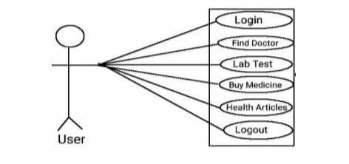
System Design And Implementations
to creating a data access layer that talks to the database, all the way
to creating an n-tier architecture approach that consists of multiple layers, and use
data-transfer objects to pass data back and forth.

Slide 11
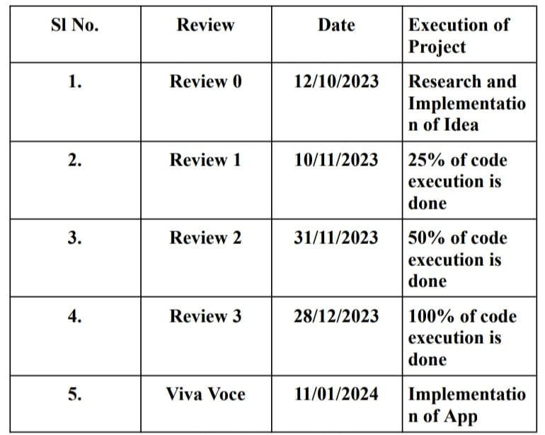
Timeline of Project

Slide 12
Outcomes / Results Obtained
Manage patient appointments, access lab test details, and provide doctor information.
This can streamline administrative tasks and improve the overall efficiency of healthcare service delivery.
Accessible healthcare information : Users can access and read healthcare articles
from the app, promoting health education and awareness among patients.
The "Buy Medicine" module allows users to purchase medicines directly through the app. This can provide a convenient and time-saving option for patients to fulfill their medication needs.

Slide 13
Conclusion
In conclusion, the research on Hospital Finder applications underscores their pivotal role in reshaping the landscape of healthcare accessibility and patient-centric services.
These applications have emerged as harnessing the power of technology to address critical challenges in navigating the complex healthcare system.
Through their intuitive interfaces and real-time information, Hospital Finder apps empower individuals to make informed decisions about their healthcare providers, optimize emergency response times, and contribute to the overall efficiency of healthcare services.
The integration of telehealth services further exemplifies their innovative approach to expanding healthcare access, especially in remote or underserved areas.

Slide 14
References
1. Agarwal, S., & LeFevre, A. E. (2017). Finding healthcare at your fingertips: A case study of apps addressing healthcare needs in India. In Proceedings of the Ninth International Conference on Information and Communication Technologies and Development (ICTD).
2. Hossain, M. S., & Ahmed, K. (2019). Telemedicine system using Hospital Finder app. In 2019 3rd International Conference on Electrical, Computer & Telecommunication Engineering (ICECTE).
3. Lasierra, N., Alesanco, Á., Guillén, S., García-Sáez, G., & García-Gómez, J. M. (2014). A survey on mobile phone tools for Hospital Finder. Journal of medical systems, 38(1), 1-9.
4. Lloréns-Montes, F. J., Ruiz-Moreno, A., & del Barrio-García, S. (2015). Hospital Finder applications and service quality: Influencing patient loyalty and recommendation. Computers in Human Behavior, 48, 542-549.
5. Mehta, N., Pandit, A., & Shukla, S. (2016). Hospital Finder mobile applications: a systematic review. International Journal of Pharmacy & Technology, 8(3), 16065-16073.
6. National Institute of Standards and Technology (NIST). (2020). Digital Identity Guidelines: Authentication and Lifecycle Management. Retrieved from https://nvlpubs.nist.gov/nistpubs/SpecialPublications/NIST.SP.800-63b.pdf

Slide 15

Thank You

